Slide 1

Name :EasyCode
Pitch deck

Slide 2
Introduction
EasyCode is an EdTech start-up
Completed 150+ paid enrollments
Has its own platform easycodeclasses.in
Has built an inter college coding community of ~1000 students
Brings freelancing opportunities
Allows enrolled students to gain freelancing experience

Slide 3

Problem Statement
Lack of guidance for freshers in tier III engineering colleges
No coding community in majority of Indian Colleges
Difficulty to catch English for Native lingual students
No idea about where to get opportunities from

Slide 4

Our Solution :
Team of experts to teach in with intuitions
Large Community of coders for extensive problem solving
Priority to Indian Languages and desi examples while teaching
Hands on Practice and freelancing projects

Slide 5
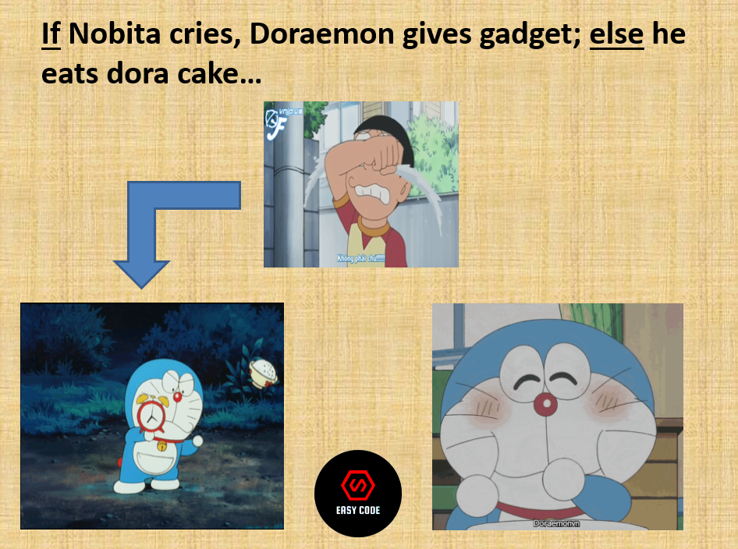
Innovation
Priority to Mother tongue/most familiar language
Learning through Intuitions/stories
Minimal cost
Doubt solving sessions

Slide 6
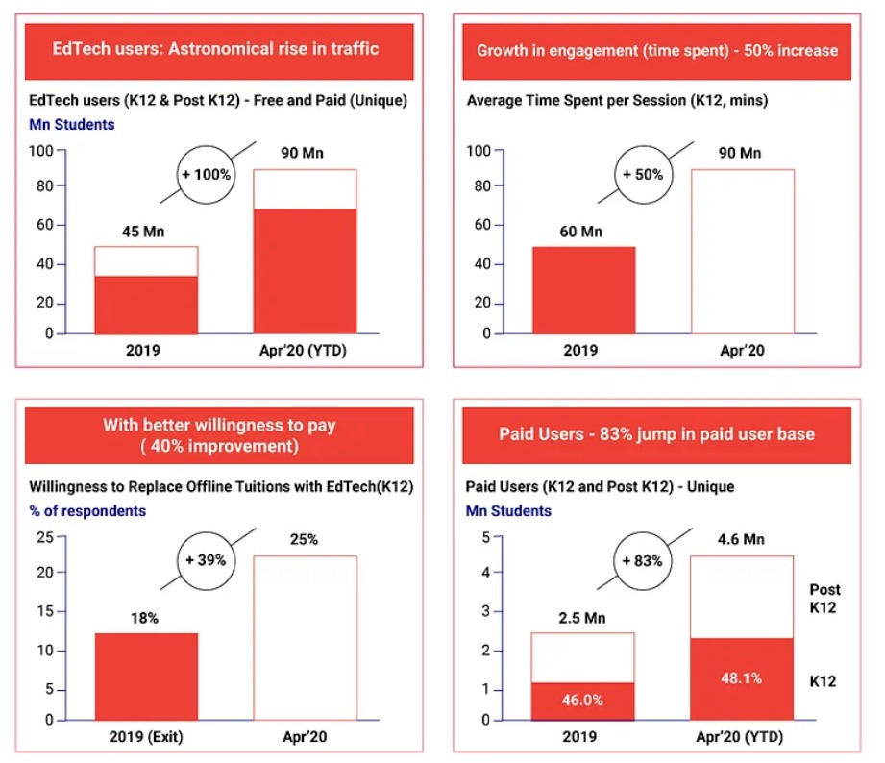
Market Size
EdTech market is estimated to sabotage from $45Mn to $90Mn
There is no prominent venture supporting Indian Languages for technical education except : GUVI
Demand for Hindi, Tamil content is exponentially growing on YouTube, but such content creators are merely professionals

Slide 7
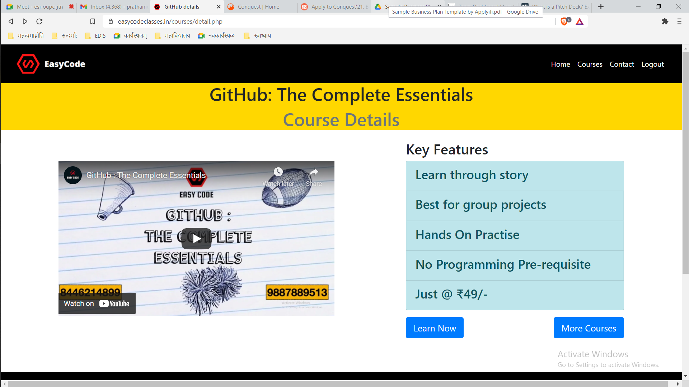
Product
Programming Courses of
C/C++
Python
Machine Learning
GitHub
Many more in the queue
EasyCode Platform

Slide 8
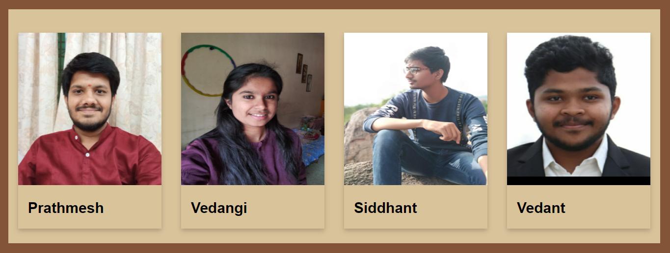



Team EasyCode

Slide 9
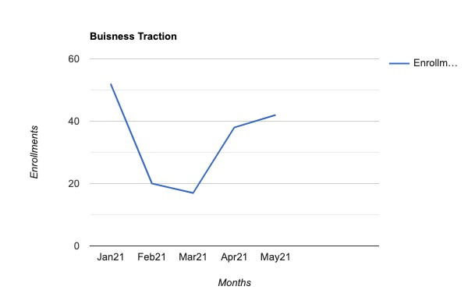
Traction
Jan 21 : C Programming
Feb 21 : C Programming
Mar21 : C Programming
Apr21 : Python + ML intro
May21: GitHub

Slide 10
Thank You

